Slide 1
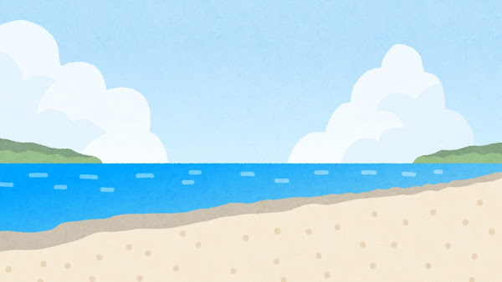

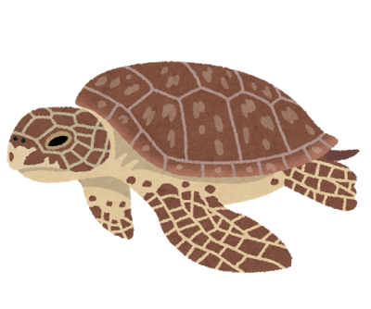
Turtle Time

Slide 2

Let’s review!
What time is it?
It’s 12 O’clock.
Notes:
Let’s talk about time! Take out your clocks! (Clock worksheet/ Paper Clock)
If students need help, have them work in pairs to remember how to tell time in English.
O’ Clock
1:30

Slide 3


Let’s tell time!
Hours:
1-12 O’clock;
Example: 3:00 = Three O’clock
Minutes:
o’ 1-9 (o’ one, o’ two, o’ three, etc. ); 1:01= one o’one
10-59, 2:15 = two fifteen
Example: 12:30 =Twelve Thirty

Slide 4

Time Practice
Notes:
What time is it?
Pair work: one student says the hour time and the other student says the minutes

Slide 5
Turtle Time

Slide 6
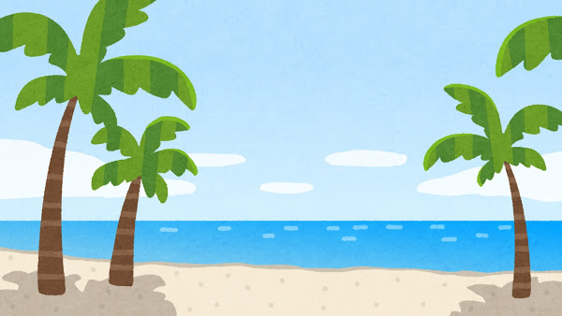

At 8 O’clock, it’s time to get up!
Good morning!
Notes:
What time did you get up? Ask students

Slide 7
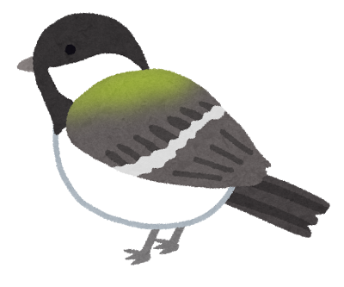
Turtle met Bird.
Hello, Bird!
Notes:
What time is it?
At 10 o’clock, what does Turtle do? Swim, Sing, Play, Eat etc.

Slide 8

Turtle asked Bird, “What time is it?”
Notes:
What time is it?
At 10 o’clock, what does Turtle do? Swim, Sing, Play, Eat etc.

Slide 9

Bird said, “It’s 10 O’clock, it’s time to sing!”
Notes:
What time is it?
At 10 o’clock, what does Turtle do? Swim, Sing, Play, Eat etc.

Slide 10




At 10 o’clock, Turtle and Bird sing.
Notes:
What time is it?
At 10 o’clock, what does Turtle do? Swim, Sing, Play, Eat etc.

Slide 11
See you later, Bird!

Slide 12
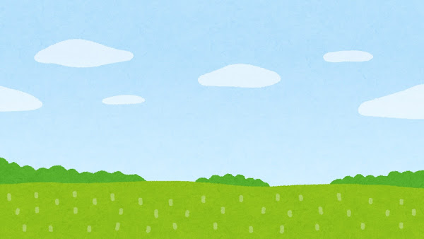
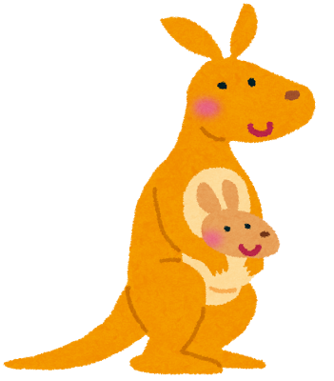
Turtle met Kangaroo.
Hi, Kangaroo!

Slide 13

Turtle asked Kangaroo, “What time is it?”
Notes:
What time is it?

Slide 14
Kangaroo said, “It’s 11:30, it’s time to jump!”

Slide 15
At 11:30, Turtle and Kangaroo jump.

Slide 16
See you later, Kangaroo!

Slide 17



At 12:00, Turtle and Panda eat lunch.
I don’t eat bamboo…
Notes:
What time do you eat lunch?

Slide 18
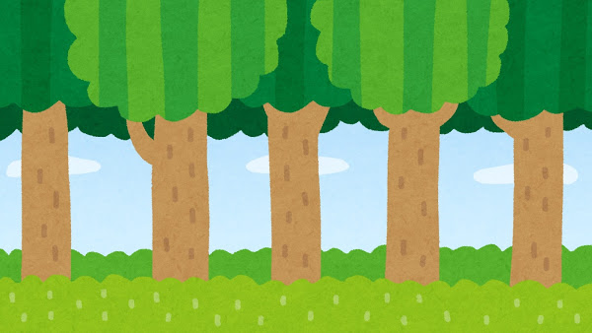

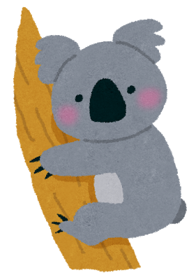
At 1:30, Turtle says hello to Koala.
Hello, Koala!

Slide 19
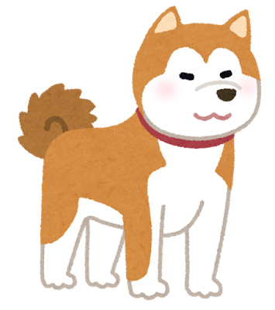
Turtle met Dog.
Hey, Dog!

Slide 20
Turtle asked Dog, “What time is it?”
Notes:
What time is it?

Slide 21

Dog said, “It’s 2:45. It’s time to run!”

Slide 22
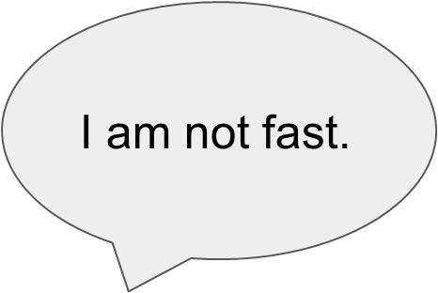
At 2:45, Turtle and Dog run.

Slide 23
See you, Dog!

Slide 24
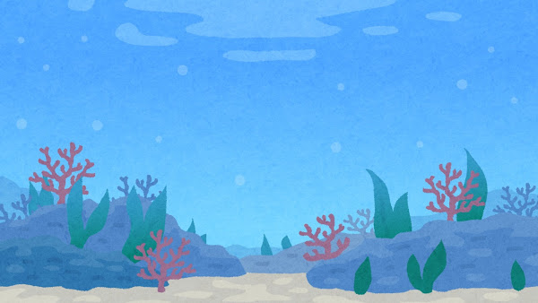
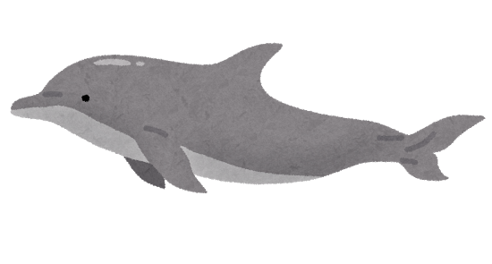
Turtle met Dolphin.
Hi Dolphin!

Slide 25
Turtle asked Dolphin, “What time is it?”

Slide 26
Dolphin said, “It’s 3:15. It’s time to swim!”

Slide 27
At 3:15, Turtle and Dolphin swim.

Slide 28
See you later, Dolphin!

Slide 29
Now, it’s 5 o’clock. Turtle has a secret.
Best time of the day!

Slide 30
Now, it’s Turtle time! Turtle likes to dance!

Slide 31


At 9 O'clock, it’s time to sleep.
Notes:
What time did you go to sleep (last night/yesterday)?

Slide 32

Good night!

Slide 33
Written by Juliana Boucree
（神奈川県立総合教育センター February 2018）
イラスト：いらすとや

